Slide 1
I. Performance Enhancement of Selectively Cloned Evolutionary Algorithm for Data Classification
II. Neuro-Swarm Approach for Data Classification
DR. DEVINDER KAUR
PRANEETH NELAPATI

Slide 2
Overview
Introduction
Iris data Classification.
Neural network architecture
Neural back propagation
Genetic algorithm
Selective cloning
Swarm Intelligence

Slide 3
Introduction
Real world systems have access to a great deal of data. A system performs efficiently when the information is properly extracted from the data.
The information from the data can be extracted only when the data is classified properly, emphasizing the significance of data classification.
Conventional Data Classification Systems Vs Intelligent Systems

Slide 4
Introduction:
Intelligent system based on Neural Networks
The Neural Network stores the knowledge in the form of interconnection strength (weights) between the neurons
Neural Network trains its parameters according to the problem domain minimizing the human intervention , overcoming the drawback of Expert systems.
The Neural Network can be trained with a back propagation algorithm or an Evolutionary technique.
However the back propagation algorithm may converge to a set of sub optimal solutions which it cannot escape, so it cannot always guarantee an optimal solution.

Slide 5
Introduction
Genetic Algorithm ensures that the obtained solution is an optimal one.
However, Genetic Algorithm involves the probability concepts that increase the number of generations taken for convergence.
The paper includes an innovative concept of Selective Cloning that improves the genetic algorithm.
Selective cloning approach is justified based on the concept of Schema

Slide 6
Iris Data Classification
The Iris data set is a multivariate data set introduced by Sir Ronald Aylmer Fisher to describe discriminant analysis.
The iris data set is the collection of 50 samples each of three plant species namely Iris Setosa, Iris Versicolor and Iris Verginica. The data set consists of sepal length, sepal width, petal length and petal width of the given plant and the corresponding species the plant belongs to.
The classification problem can be explained as: Based upon the given plant’s sepal and petal lengths and widths, it should be classified into one of the three species.
Each species has no distinguishable length and width ranges, based upon which the classification is done.

Slide 7
Iris Data Classification
Sepal Length | Sepal Width | Petal Length | Petal Width | Species
5.1 ….. ….. ….. ….. | 3.5 ….. ….. ….. ….. | 1.4 ….. ….. ….. ….. | 0.2 ….. ….. ….. ….. | Setosa
6.0 ….. ….. ….. ….. | 3.4 ….. ….. ….. ….. | 4.5….. ….. ….. ….. | 1.6 ….. ….. ….. ….. | Versi-color
6.0 ….. ….. ….. ….. | 3.0 ….. ….. ….. ….. | 4.8 ….. ….. ….. ….. | 1.8 ….. ….. ….. ….. | Virginic-a
Extract from the Iris Data Set

Slide 8
Neural Network Architecture
A Neural Network is a collection of artificial neurons arranged in multiple layers in a feed forward fashion.
A Neuron is represented with a mathematical model that takes in multiple inputs to generate a single output.
The input layer has four neurons that correspond to the four plant characteristics of sepal length, width, and petal length, width.
There is one hidden layer with three neurons.
The output layer has three neurons corresponding to the three plant species, namely Iris Setosa, Iris Versicolor and Iris Verginica.

Slide 9
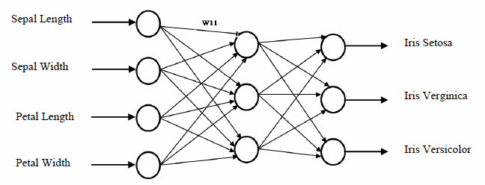
Neural Network Architecture
The Neural Network for the Iris Data problem
The activation function used for the neural network is the sigmoid function. The sigmoid function can functionally be represented as
Sigmoid(x) =1/ (1+e^{-x})

Slide 10
Nerual Back Propagation
The back propagation is one of the most common approaches to train a Neural Network.
The error is calculated by comparing the actual outputs with the desired outputs, and this error which is propagated backwards is used to adjust the weights of the network.
The back propagation algorithm for the Iris data problem is structured with momentum term so as to ensure better performance. The momentum term can be shown in the generalized delta rule.

Slide 11
Nerual Back Propagation
Where β is the momentum term,
ΔW_{jk}(p-1) is the weight correction(between j’th neuron and k’th neuron present in the adjacent layers) in the p’th iteration ,
ΔW_{jk}(p) is the weight correction in the p’th iteration ,
α is the learning rate parameter ,
y_{j}(p) is the output of the j’th neuron in the p’th iteration,
δ_{k}(p) is the error gradient of k’th neuron in the p’th iteration.

Slide 12
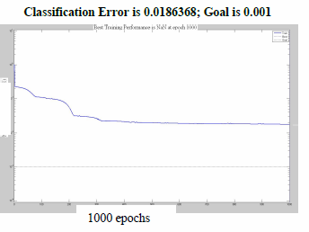
Nerual Back Propagation
Learning Rate of a Back Propagation Algorithm
Initially, the error for the random weights is very large( found to be in the range of 0.5 to 0.8)
The error is found to decrease at a consistent pace till 200 epochs . From 200 epoch, the error was found to be decreasing more slowly and by the end of 1000 epoch error was found to be in the range of 2x10⁻²

Slide 13
Genetic Algorithm
The Genetic Algorithm is a global computational search technique used for extracting optimized solutions .
Initially, the neural network of fig.1 is represented as a chromosome.
A population of 100 such chromosomes is generated. Using Genetic algorithms, the best chromosomes will be evolved, which represent the best neural networks with weights that minimize the classification error.

Slide 14
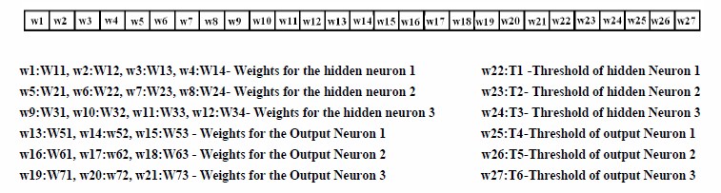
Genetic Algorithm
Neural Network represented as a chromosome

Slide 15
Genetic Algorithm
The fitness criterion is the inverse of mean square error i.e. the chromosome which has the least mean square error for data classification has the highest fitness.
The fitness of the chromosomes is calculated. These chromosomes are then allowed to reproduce by cross breeding.
For Creation of next generation, the parent chromosomes are chosen from the population, the fitness being the guiding criterion.
The fittest chromosome has more probability of being selected as a parent. The crossover and the mutation operators are being used to generate the next generation of chromosomes known as the offspring.

Slide 16
Genetic Algorithm
The crossover operator interchanges the genes of the chromosomes, so that the resulting chromosome has the good characteristics of both its parents.
The Mutation operator expands the search space ensuring that the solution obtained at the end is optimal (and not localized).
For the Iris data classification, the chromosomes are operated with crossover operator (which uses a scattered property) and Mutation( a Gaussian Function) are used to generate the next generation.
The GA is then presented with the training data

Slide 17
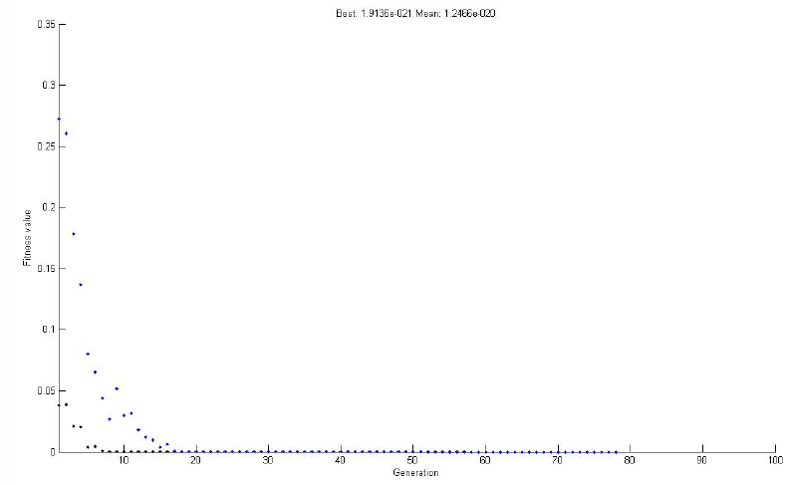
Genetic Algorithm
Convergence of a GA
The best trained network is obtained within 20 generations

Slide 18
Effects of inappropriate crossover operator
The crossover operator has a significant effect on the performance of the genetic algorithm.
Improper crossover operator can destroy the essential schema instances passing from one generation to the next.
To observe this effect, a random crossover operator is chosen (crossover positioning and length is randomly chosen).
The random crossover operator that interchanges the first ten genes of the parent chromosomes this crossover operator is used to generate the next generation chromosomes for the iris data classification.

Slide 19
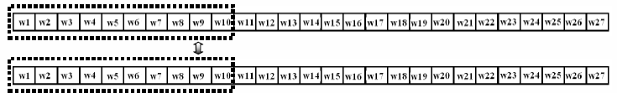
Effects of inappropriate crossover operator
Random crossover operator

Slide 20
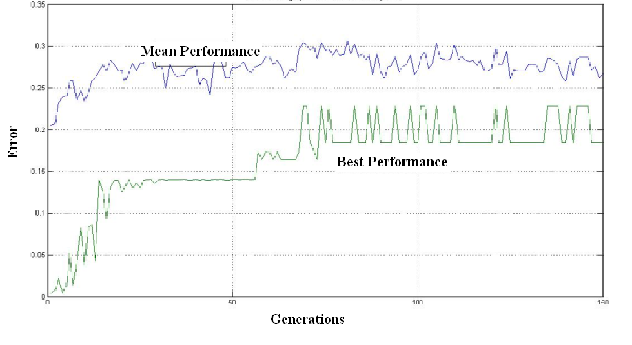
Effects of inappropriate crossover operator
Destructive effect of improper crossover operator
the error in the data classification did not reduce and the performance did not improve.

Slide 21
Selective Cloning
Selective cloning is a computational approach of selecting the parent over the offspring, when the fitness of the parent is superior to the fitness of the offspring.
This approach can guarantee a definite and a faster convergence.
The roots for selective cloning lie in the schema theorem. A schema is a set of bit strings of ones, zeros and asterisks, where each asterisk can assume the value of one or zero.
According to the schema theorem, one can predict the presence of a schema in next chromosome generation.
For faster convergence, the fittest schema traces must be increased from generation to generation for the network to converge

Slide 22
Selective Cloning
In Selective Cloning, a random crossover length and position are chosen.
This crossover operator can break some of the schema instances of A and may not disturb the others.
Thus, the offspring that contains the instances of A are of higher fitness and hence passed to next generation.
The offspring that do not contain instances of A show poor fitness than the parents and hence instead of passing the offspring to the next generation, the parents are passed on to the next generation (cloning).
This approach guarantees the increase in population containing instances of A from generation to generation (hence guarantees definite increase in generation fitness and hence convergence), irrespective of crossover operator length and positioning.

Slide 23
Selective Cloning: Mathematical Background
Let ‘m’ be the total chromosome population in any generation.
Let the optimality fitness criterion is defined as more the number of chromosome population possess the instances from a given schema H, more is the overall fitness of the population. The population in any generation is constant.
In the i_{th} generation,
m_{H}(i)=Total Chromosome population containing instances from schema H.
m_{H}’(i)=m-m_{H}(i)= Total Chromosome population that do not contain instances from schema H.

Slide 24
Selective Cloning: Mathematical Background
Then by applying crossover and mutation operators, offspring are generated.
M_{H}(i)=Total Chromosome population containing instances from schema H.
M_{H}’(i)=m-M_{H}(i) = Total Chromosome population that does not contain instances from schema H.
The crossover and mutation operators may work in such a way that, some of the offspring of m_{H}(i) population may lack instances from schema H and remaining possess the instances from schema H.
m_{H}(i) → a*M_{H}(i)+b*M_{H}’(i)
Where
a= fraction of offspring population from m_{H}(i) containing instances from schema H.
If,
f(i)=offspring population from m_{H}(i) that contain instances from Schema H.
g(i)=Total offspring containing instances from Schema H.

Slide 25
Selective Cloning: Mathematical Background
Then,
a=f(i)/g(i)
b= fraction of offspring population from m_{H}(i) that do not contain instances from schema H
If,
j(i)=offspring population from m_{H}(i) that do not contain instances from Schema H.
k(i)=Total offspring containing instances from Schema H.
Then,
b=j (i)/k(i)
a and b have the range [0,1] and
a+b=1.
Then,
m_{H}’(i)→ c.M_{H}(i)+d. M_{H}’(i)
c= fraction of offspring population from m_{H}’(i) containing instances from schema H
If,
l(i)=offspring population from m_{H}’(i) that do not contain instances from Schema H.
n(i)=Total offspring containing instances from Schema H.
c=l(i)/n(i)
Then,
d= fraction of offspring population from m_{H}’(i) that do not contain instances from schema H

Slide 26
Selective Cloning: Mathematical Background
If
p(i)=offspring population from m_{H}’(i) that do not contain instances from Schema H.
q(i)=Total offspring containing instances from Schema H.
d=p(i)/q(i)
Then,
and, c+d=1.
Now in Selective Cloning approach, the offspring’s fitness is compared with the fitness of parents,
Thus,
b*M_{H}’(i) population has less fitness when compared to its parents and hence are replaced by their parents.
c*M_{H}(i) population has higher fitness than their parents and hence they replace their parents in the next generation.
Thus after applying the selective cloning and generate the actual new generation, then the next generation chromosome population containing instances from schema H are
m_{H}(i+1)= m_{H}(i)+ c*M_{H}(i).

Slide 27
Selective Cloning: Mathematical Background
The worst case scenario is that when c=0, which is a rare case, when
m_{H}(i+1)= m_{H}(i)
Therefore
m_{H}(i+1) ≥ m_{H}(i).
This ensures that selective cloning ensures fitness improvement and so convergence.

Slide 28
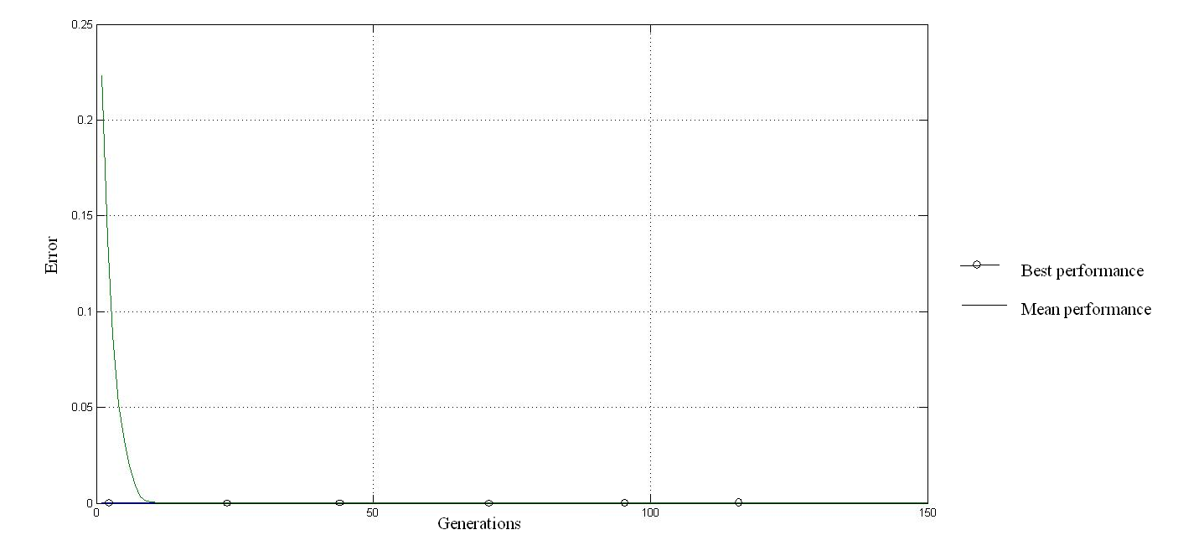
Selective Cloning
Performance Graph of Selectively Cloned Genetic Algorithm

Slide 29
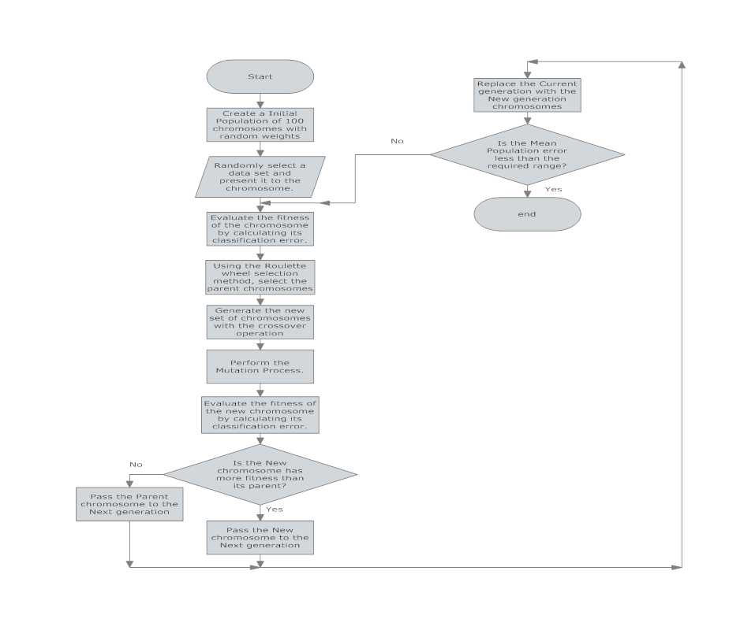

Slide 30
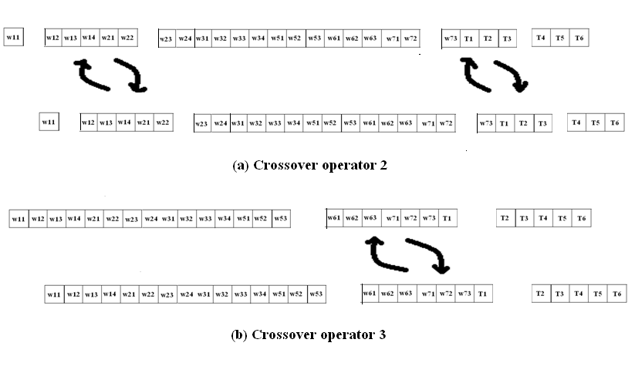
Performance of SC with various crossover operators
Fig 8: Crossover operators

Slide 31
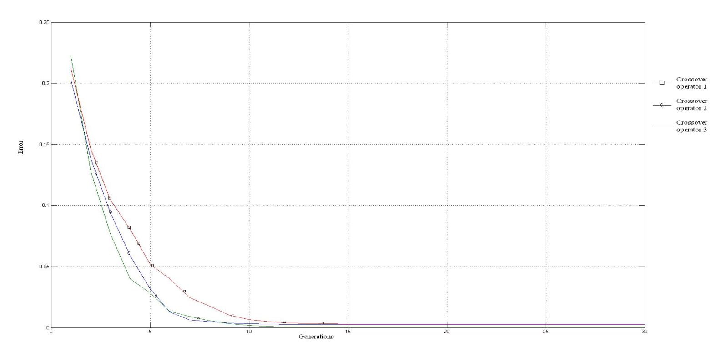
Performance of SC with various crossover operators
Performance comparison of genetic algorithms with different crossover operators.

Slide 32
Swarm Intelligence
Social behavior is an important attribute in the human society.
collective intelligence
Applications
This kind of social behavior is also prominent in the life cycles of many other living organisms.

Slide 33
Swarm Intelligence
Swarm Intelligence is the discipline that deals with natural and artificial systems composed of many individuals that coordinate using decentralized control and self-organization.
The discipline focuses on the collective behaviors that result from the local interactions of the individuals with each other and with their environment.

Slide 34
Swarm Intelligence
Swarm systems, typically are made up of a population of simple agents or boids interacting locally with one another and with their environment.
agent-based modeling.
The basic principle of swarming is very simple: by having a relatively large number of agents following very simple rules, complicated group-behaviors can be generated.

Slide 35
Principles
Homogeneity: Every member in the group has the same behavioral pattern. Though the group seems to lack a leader, temporal leader seem to appear.
Locality: Each member of the group can only influence members in its close proximity.
Collision Avoidance: Avoid collision with the neighbors or avoid interfering directly with the neighbors.
Velocity Matching: Every member tries to match velocity with nearby group members.
Flock Centering: attempt to stay close to nearby members.

Slide 36
Ant Colony Optimization(ACO)
Ants: social creatures
Ant colonies are highly structured social organizations.
Achieve complex tasks, which far exceed the capabilities of an individual ant .
Foraging: Highly studied approach

Slide 37
ACO Features
ACO best suites the applications that require multiple agents with decentralized control like wireless network routers, sensors or group of robots.
Ant behavior is easy to model and implement in the real world applications.
ACO is a efficient generic algorithm that works for any optimization problem that can be formulated in terms of an objective function.
Mathematically proven to converge with accuracy in some domains.

Slide 38
ACO Features
It is faster than other approximate methods for solving optimization problems.
The Major advantage is that the ACO characteristics can be defined to suit the domain making it highly Flexible.
Ant Colony Optimization is a potential tool for efficiency

Slide 39
Particle Swarm Optimization(PSO)
PSO is another technique to solve real world problem that lack any mathematical model.
The technique involves in launching a group of agents randomly in the search space and assign some kind of measuring technique that assess whether a particle( Agent) is directed towards the global solution or not.

Slide 40
PSO: Rules
Separation: Each agent tries to move away from its neighbors if they are too close.
Alignment: Each agent steers towards the average heading of its neighbors.
Cohesion: Each agent tries to go towards the average position of its neighbors.

Slide 41
PSO: similarity with evolutionary computation
PSO shares many similarities with evolutionary computation techniques such as Genetic Algorithms (GA).
The system is initialized with a population of random solutions and searches for optima by updating generations.
Unlike GA, PSO has no evolution operators such as crossover and mutation. In PSO, the potential solutions, called particles, fly through the problem space by following the current optimum particles.

Slide 42
PSO
Each particle keeps track of its coordinates in the problem space which are associated with the best solution (fitness) it has achieved so far. (The fitness value is also stored.) This value is called pbest or the previous best.
Another "best" value that is tracked by the particle swarm optimizer is the best value, obtained so far by any particle in the neighbors of the particle. This location is called lbest or the Local best.
When a particle takes all the population as its topological neighbors, the best value is a global best and is called gbest or the global best.

Slide 43
PSO
The particle swarm optimization concept consists of, at each time step, changing the velocity of (accelerating) each particle toward its pbest and lbest locations (local version of PSO).
Acceleration is weighted by a random term, with separate random numbers being generated for acceleration toward pbest and lbest locations.
The main reason for which PSO is attractive is that there are few parameters to adjust. One version, with slight variations, works well in a wide variety of applications.

Slide 44
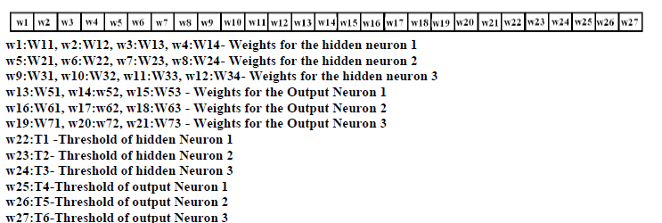
Swarm Modeling
Swarm Particle

Slide 45
Swarm Algorithm
The swarm algorithm creates a fixed number of swarm particles at random positions.
The aim of the algorithm is to reduce the mean classification error of the group of swarm particles to an acceptable value.
The swarm particles have to work as individual units that collectively form a whole unit.
Search Space
Broadcating

Slide 46
Principles
Homogeneity: All the swarm particles are created alike with a string of 27 real numbers (each representing a weight or threshold).
Locality: Locality defines the range within which the swarm particle can communicate other swarm particles.
Validation of choosing broadcasting or global communication mechanism.

Slide 47
Principles
Collision avoidance: Since the swarm particles are adjusting their weights and thresholds independently without interfering in the weight adjustments of its neighbors, collision avoidance is ensured.
Velocity Matching is a key attribute in the swarm approach because it influences the convergence time.
Each swarm particle is assigned a velocity component. The velocity component controls the magnitude and direction of the weight change of the swarm particle.

Slide 48
Principles
The velocity is made directly proportional to the difference in the fitness levels of the swarm particle and the global best or leader.
Swarm particles cannot be influenced on a large scale by its neighbors or in this case, the global leader over its sensing capabilities.

Slide 49


Principles
Particle ‘b’ is supposedly at the local maximum forming a temporal leader.
Particle ‘a’ is at a point which is very close to the global best.

Slide 50
Principles
Weight adjustment= initial weight+ (α)*(β)*(δ)
α =Learning rate
β=fitness of the swarm leader-fitness of the swarm particle
δ=weight of the swarm particle-weight of the swarm leader
β denotes the speed term, which defines the speed with which the particle has to travel towards the leader.
δ denotes the direction in which the weight has to be modified.
β*δ defines the velocity of the swarm particle.

Slide 51
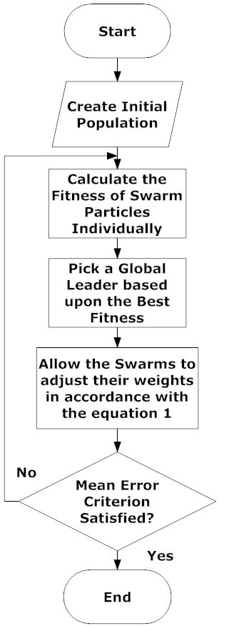
Swarm Algorithm
Flow Chart of Swarm Algorithm

Slide 52
Step 1: The swarm particles with identical behavioral model are created.
Step2: The fitness, inverse of the mean square classification error is calculated for all the swarm particles.
Higher the mean error lower is the fitness of the particle higher is the fitness.
Step 3: The swarm particle with highest fitness is identified and declared as the global leader.
The global leader directs the particles towards better classification results

Slide 53
Step 4: The other swarm particles tend to follow the leader each equipped with different velocities. The swarm particle with least fitness is provided with high velocities when compared to the particles with better fitness.
Locality.
Step 6: The leading swarm particle is allowed to explore its surroundings for better fitness.
Step 7: The fitness is calculated for all the particles to decide upon the group leader. It can be observed that the same swarm particle may not be the leader every time.

Slide 55
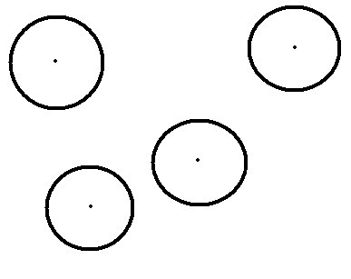
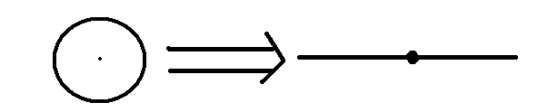
Swarm Leader Weight Adjustment
Ant Pheromone Sensing Capability
Transformation depicting swarm Leader

Slide 56
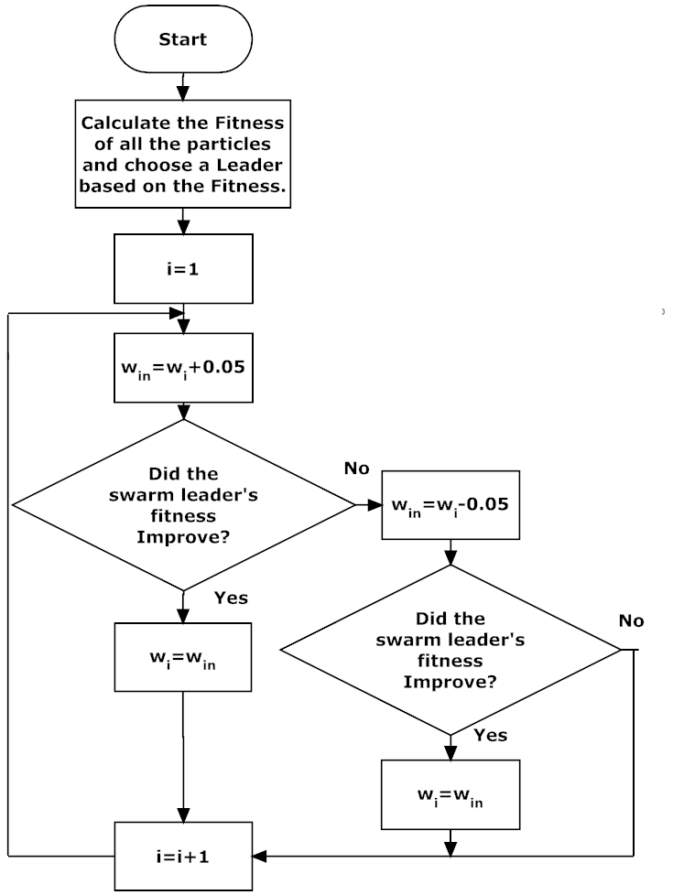
Exploration of surroundings by the swarm leader

Slide 57
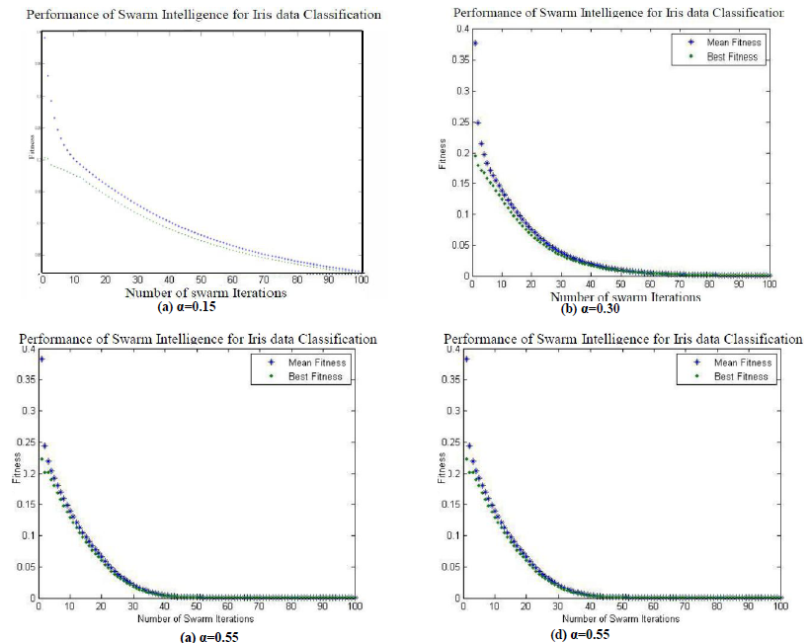
Performance of Swarm Algorithm

Slide 58
Comparison of Various Algorithms
Technique Used | Number of epochs or generations required for convergence | Best error that could be achieved at the end of convergence | Time Required for the convergence | Converging Time required for the entire program | Time efficiency compared to Back propagation
Swarm Algorithm | 5 iterations | 0 | 0.1505 sec | 5.8598 sec | 97.76%
Back Propagation Algorithm | 1000 epochs | 0.02 | 6.739 sec | 6.739 sec | -
Genetic Algorithm | 18 generations | 0(as 1.9x10⁻²¹is appx as 0) | 1.45 sec | 12 sec | 78.4%
Genetic Algorithm with selective cloning | 12 generations | 0 | 0.272 sec | 2.086 sec | 95.96%

Slide 59


